Slide 1

Traffic Speed detect & Accident Report

Slide 2
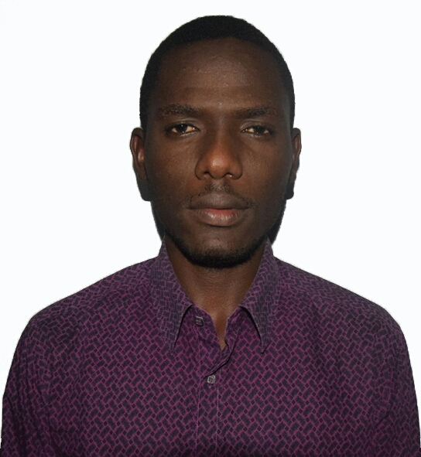
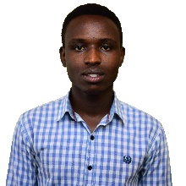
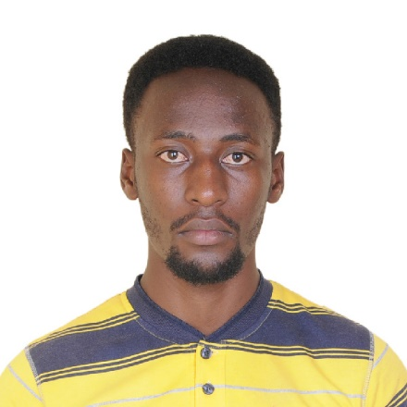
Group Members
01
NGABO MUGISHA Robert
MUTUYIMANA Janvier
NZIMENYERA Innocent

Slide 3



Statement of problem
Reports
Many Reports are available from different sources
Reports
TIME
Overspeed Violation
corruption
Detect overspeed violation require pocile man around
Overspeed
violation
TIME
AID not Available on time

Slide 4
SPECIFIC OBJECTIVES
AVOID CORRUPTION
ABUSE OF SPEED LIMIT
NO ONE TO TALK TO
24/7 AUTO DETECT
SAVE LIVES
2
INCOME
4
AS ACCIDENT REPORT SENT IMMEDIATELY
CHARGES
3
1

Slide 5


RESEARCH METHODOLOGY
DATA AND INFORMATION COLLECTION TECHNIQUES
DOCUMENTATIONS
It is a technique of searching in books or other publications available in libraries or on-line (internet) that help in finding data to be useful for the topic under the study
Observation
Observation is an action of an attentive follow-up of a phenomenon in order to draw a conclusion.
Interview
The interviews are the most common and most satisfactory way of obtaining information about the objectives, constraints, allocation of duties and problems and failures in the existing system.

Slide 6
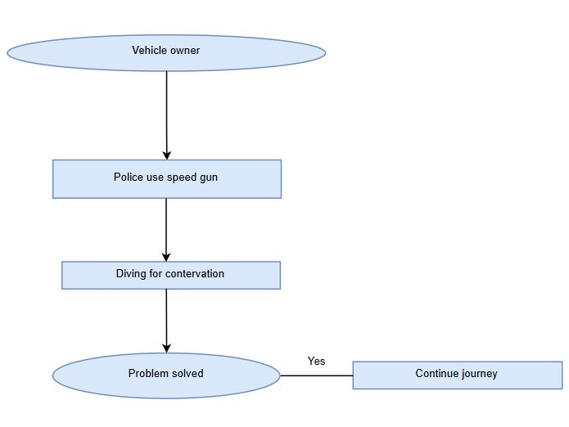
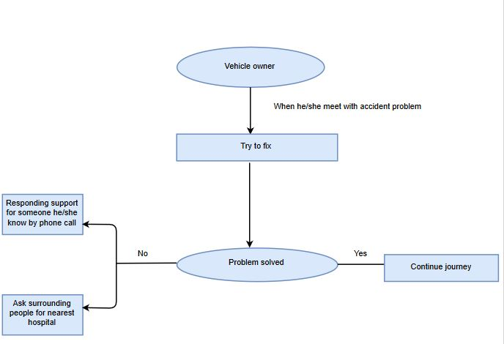
EXISTING SYSTEM
Speed detection
Accident report process

Slide 7
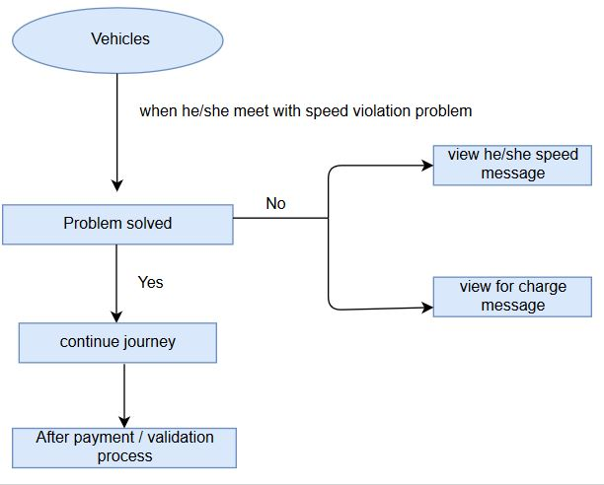
PROPOSED SYSTEM
Speed Detection

Slide 8
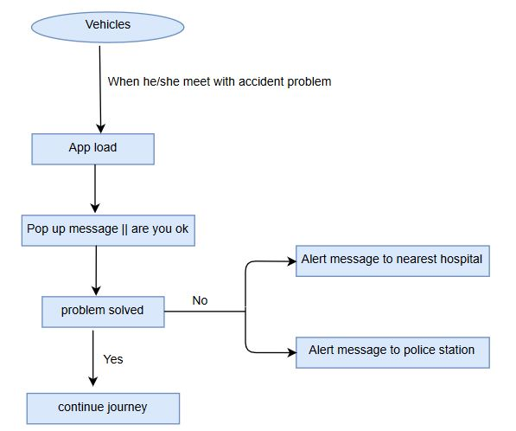
PROPOSED SYSTEM(CONT..)
Accident report

Slide 9
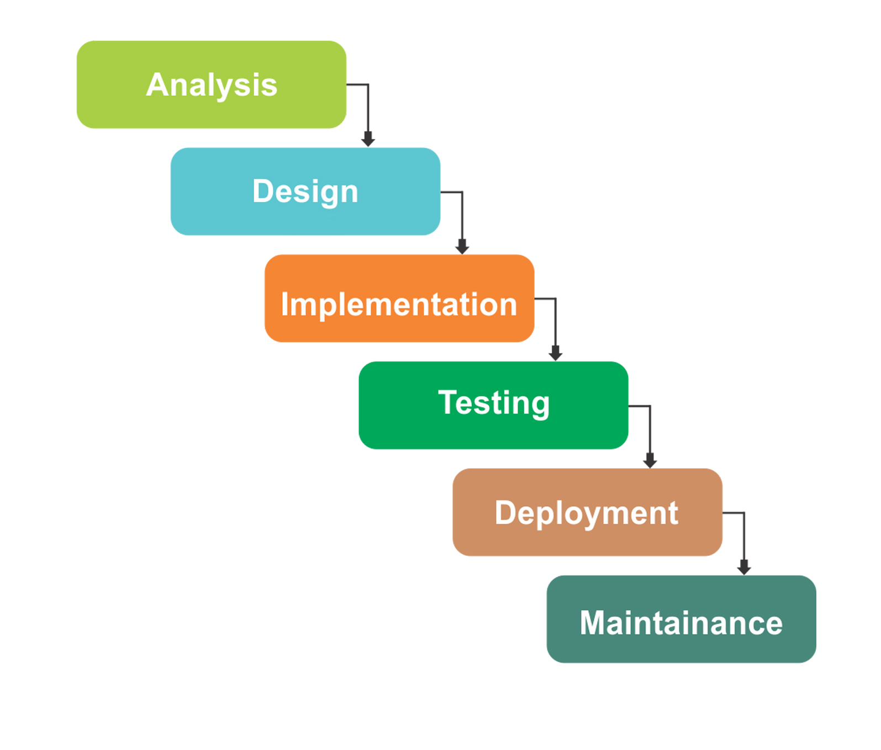
WATERFALL MODEL

Slide 10
WHAT MAKES OUR SYSETEM SPECIAL
AVAILABLE 24/7
SAVE LIVES
AVOIDANCE OF CORRUPTION IN TRAFFIC

Slide 11
TECHNOLOGIES USED
BACK-END
Android
PHP
JAVASCRIPT
Java for android
Google map API
OCR API
FRONT-END
HTML5
CSS3
BOOTSTRAP

Slide 12
CONCLUSION & RECOMMENDATION
As technology developing rapidly that is why project have developed, a project focuses about how the process of getting support of Rushing driver can be computerized. By implementing the goal of this study, which was to develop a sensor based application that used as a tool which facilitate car owners and passengers to get assistance in their daily journey.
Our recommendation goes to students of university of Rwanda to those Researchers especially in the Information Technology, by encouraging them to continue developing solutions to the society and contribute to the country development because that is what as IT people we have to do

Slide 13

T H A N K S F O R W A T C H I N G

